Slide 1
Machine Learning
Assumptions of Regression and Model Evaluation

Slide 2
Assumptions of linear regression
The dependent variable must be numeric
Linear relationship between dependent and independent variables
Predictors must not show multicollinearity
Independence of observations should exist (Absence of Autocorrelation)
The error terms should be homoscedastic
The error terms must follow normal distribution
Better assumptions → Better models → Better decisions

Slide 3
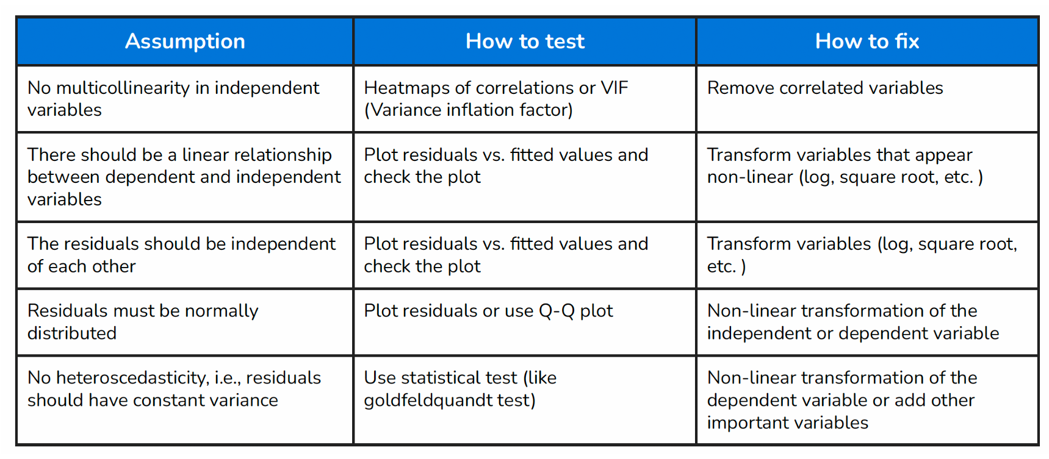

Slide 4
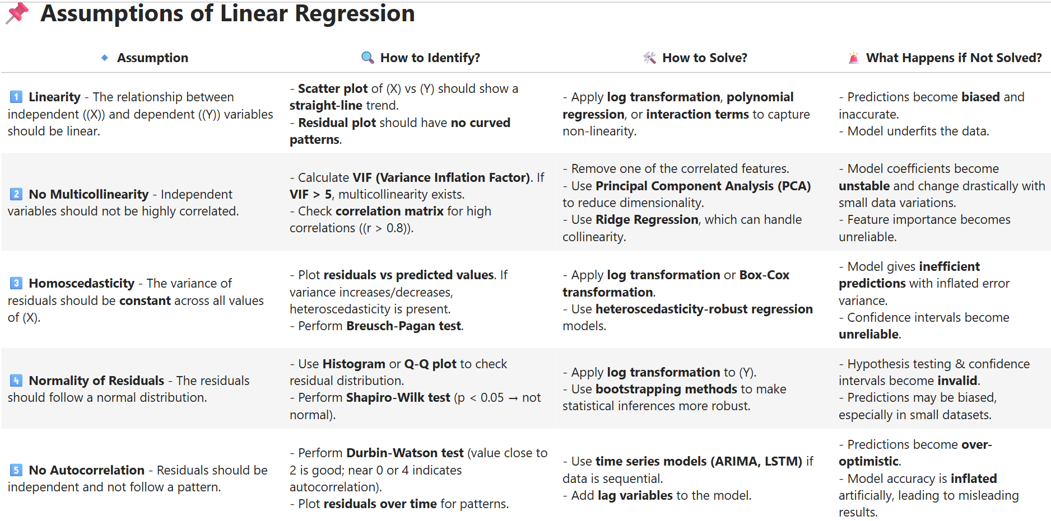

Slide 5
Assumptions of linear regression
Numeric dependent variable
Absence of Multicollinearity
Assumption to be checked before building a model
Build a model
Linear relationship
Absence of Autocorrelation
Error terms should be homoscedastic
Error terms must follow N(0,σ²)
Assumption to be checked after building a model

Slide 6
Tests for Assumptions of Linear Regression

Slide 7
Tests before model building
The dependent variable must be numeric
Predictors must not show multicollinearity

Slide 8
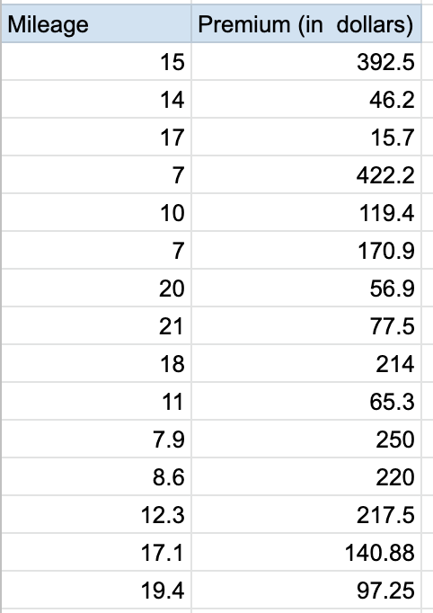
Is the dependent variable numeric?
Regression Analysis requires the target variable to be numeric in nature
For example: returns, sales of a product, yield of a crop, risk in financial services
In context with our example, we see that Premium is numeric

Slide 9
Q & A
Question:
If our target variable is: 0, 1, 1, 0, 0, where 0 indicates presence of a disease and 1 indicates absence.
Is it appropriate to use regression to find the whether the person has a disease?

Slide 10
Q & A
Question:
If our target variable is: 0, 1, 1, 0, 0, where 0 indicates presence of a disease and 1 indicates absence. Is it appropriate to use regression to find the whether the person has a disease?
Answer:
No. Because the target variable is a categorical variable. Thus, it is a classification problem.

Slide 11
Tests before model building
The dependent variable must be numeric
Predictors must not show multicollinearity

Slide 12
What is multicollinearity?
Multicollinearity arises when the independent variables have high correlation among each other
Radio spend and Newspaper spend may be correlated.
Health_Benefits and Total_Benefits may be correlated
In presence of it, the best fit line obtained from OLS method is no more “best”

Slide 13

Multicollinearity detection
Determinant of correlation matrix
Condition Number (CN)
Correlation matrix
Variance Inflation Number (VIF)
Is there multicollinearity present?
Which variables are involved in multicollinearity?

Slide 14
Is there multicollinearity?
import numpy as np
corr_matrix = X.corr()
det_corr = np.linalg.det(corr_matrix)
print("Determinant:", det_corr)
Determinant of the correlation matrix:
Let D be the determinant of correlation matrix. Then 0 < D < 1
Condition Number (CN):
CN > 1000 | Severe multicollinearity
100 < CN < 1000 | Moderate multicollinearity
100 < CN | No multicollinearity
D=0 | High multicollinearity
D=1 | No multicollinearity

Slide 15
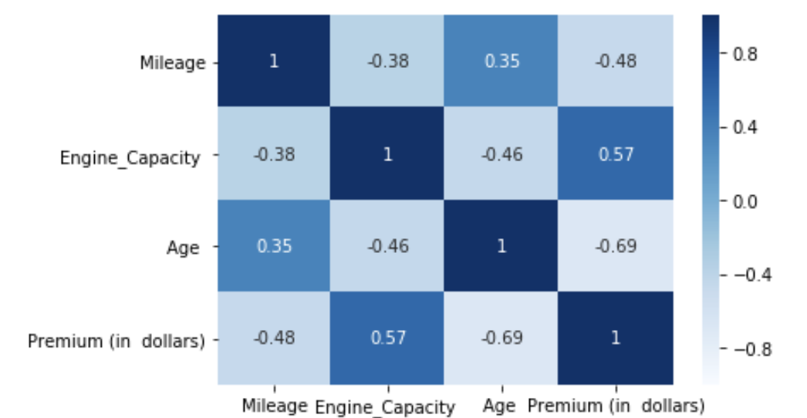
Which variables are involved in multicollinearity?
Correlation matrix:
If the off-diagonal values tend to 土1 then it indicates high correlation between the variable pair. However this inspection is not enough
High correlation between two predictors suggests they carry overlapping information, meaning one doesn’t add much new signal beyond the other. If you detect such patterns, it’s a red flag for potential multicollinearity - consider removing, combining, or transforming variables, or switching to regularization models like Ridge or Lasso

Slide 16
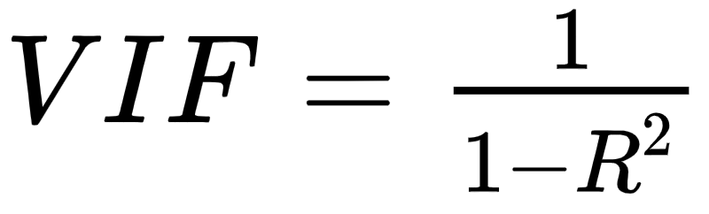
Which variables are involved in multicollinearity?
Variance inflation factors measure the inflation in the variances of the regression parameter estimates due to collinearities that exist among the predictors.
Variance Inflation Factor (VIF):
Where R² is obtained by regressing a predictor variable over all the other predictors in the model
Value | Interpretation
VIF > 5 | High correlation
5 > VIF >1 | Moderate correlation
VIF = 1 | No correlation

Slide 17
Tests after model building
Linear relationship between dependent and independent variables
Independence of observations should exist (i.e. Absence of Autocorrelation)
The error terms should be homoscedastic
The error terms must follow normal distribution

Slide 18
Tests after model building
Linear relationship between dependent and independent variables
Independence of observations should exist (i.e. Absence of Autocorrelation)
The error terms should be homoscedastic
The error terms must follow normal distribution

Slide 19
Assumption of linearity
An assumption of linear regression is that it should be linear in the parameter
The independent variables must have a linear relationship with the dependent variable
The residuals and the fitted values should be independent
The independent variables must have a linear relationship with the dependent variable
This can be checked plotting a scatter plot of residuals vs predictors
A scatter plot depicting no pattern indicates that the variable has a linear relationship with the response variable

Slide 20
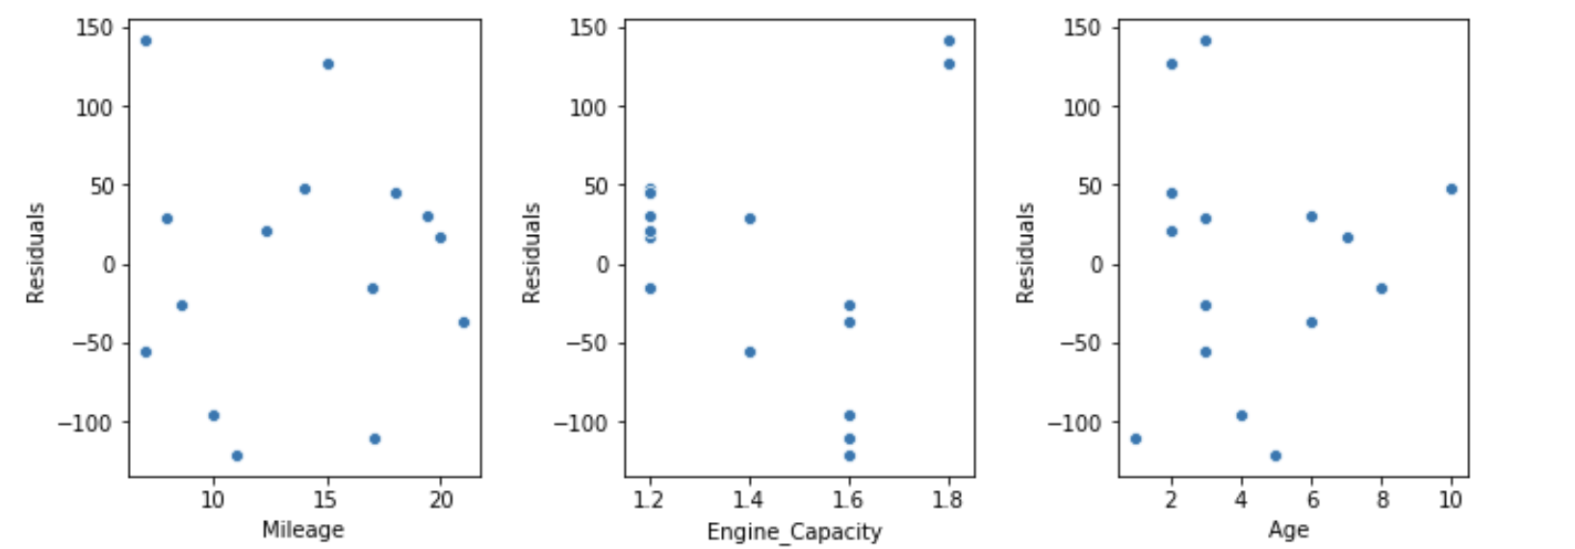
Existence of linear relationship
Residual plot shows:
Random scatter
No curve
No U-shape
No increasing or decreasing pattern
👉 Means relationship is linear
In context with our data, we see a random pattern in all the three plots. Hence, we may say that, the predictors are linearly related with the response variable.

Slide 21
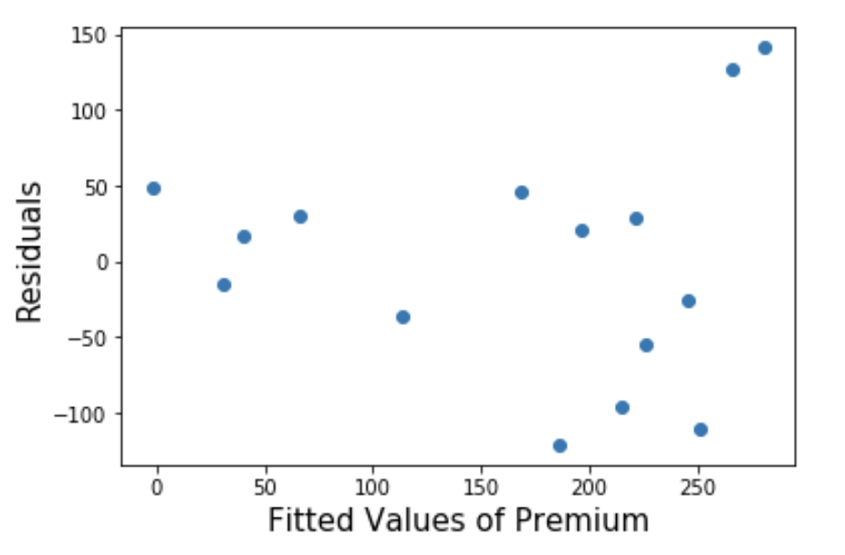
Existence of linear relationship
The plot of residuals against the fitted tells the presence of linear relationship
For linear relationship, the points must be at random, i.e., it should not exhibit much distinctive pattern, no non-linear trends or changes in variability

Slide 22
Tests after model building
Linear relationship between dependent and independent variables
Independence of observations should exist (i.e. Absence of Autocorrelation)
The error terms should be homoscedastic
The error terms must follow normal distribution

Slide 23
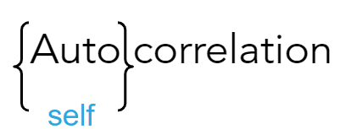
Assumption of autocorrelation
Assumption of autocorrelation is violated when residuals are correlated within themselves, i.e. they are serially correlated
Autocorrelation does not impact the regression coefficients but the associated standard errors are reduced
This reduction in standard error leads to a reduction in associated p-value
It incorrectly concludes that a predictor is statistically significant

Slide 24
Example of Autocorrelation
Imagine predicting monthly sales.
If sales were high last month, they will likely be high this month too.
So the error of month t is similar to the error of month t-1.
This pattern in errors = autocorrelation.
Residual at time t depends on residual at time (t-1)
or
Errors follow a pattern when they should be random.

Slide 25
Causes of autocorrelation
Some important variables are not considered in the data
If the relationship between the target and predictor variables is non-linear and is incorrectly considered linear
Presence of carry over effect
Example: The additional expenses from the budget for last month are carried over in creating the budget for next month

Slide 26
Durbin - Watson Test
To test whether the error terms are autocorrelated,we Durbin-Watson test
We test whether autocorrelation is present or not
The hypothesis is given by:
against
H₀:The error terms are not autocorrelated
H₁:The error terms are autocorrelated
Failing to reject H₀, will imply that the error terms are autocorrelated

Slide 27
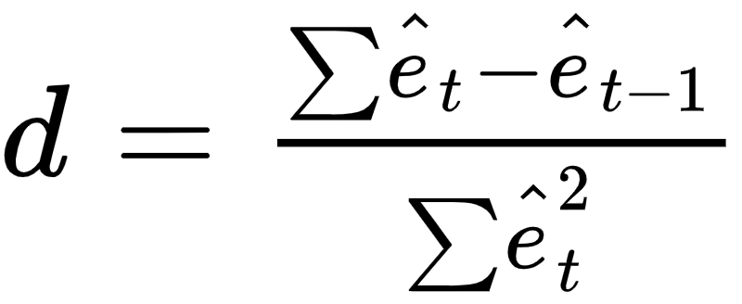
Durbin - Watson test
The test statistic is given by
Residual of t^{th} observation
Residual of t-1th observation
d ∈ [0,4]
Value | Interpretation
0 < d <2 | Positive autocorrelation
d = 2 | No autocorrelation
2 < d < 4 | Negative autocorrelation

Slide 28
Autocorrelation
2. Autocorrelation Plot (ACF Plot)
A visual way to detect autocorrelation in residuals.
Python Code:
from statsmodels.graphics.tsaplots import plot_acf
import matplotlib.pyplot as plt
residuals = model.resid plot_acf(residuals)
plt.show()
✔ Interpretation
Bars extending beyond the blue boundary → autocorrelation exists.
Bars within boundary → no autocorrelation.

Slide 29
Tests after model building
Linear relationship between dependent and independent variables
Independence of observations should exist (i.e. Absence of Autocorrelation)
The error terms should be homoscedastic
The error terms must follow normal distribution

Slide 30
Homoscedasticity assumption
Homoscedasticity
Same
Variance
Variance of the residual is assumed to be independent of the explanatory variables
Heteroscedasticity: non-constant variance of residuals
It happens due to the presence of extreme values

Slide 31
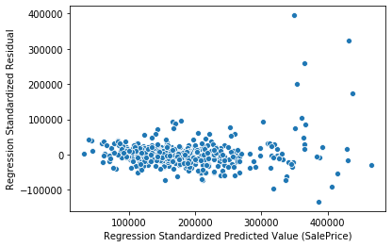
Heteroscedasticity
Funnel type shape is seen in the graph
Hence we can say that there is a presence of “Heteroscedasticity”

Slide 32
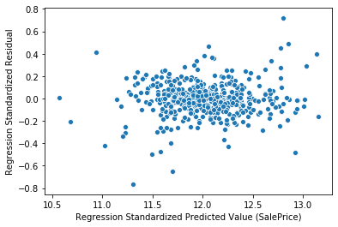
Homoscedasticity
There is no visible funnel or bow type pattern in the plot
We can see presence of “Homoscedasticity”

Slide 33
Residual vs Fitted plot
The plot of residuals against the fitted values tells whether the error terms have equal variance
It should look random, i.e., it should not exhibit much distinctive pattern, no non-linear trends or changes in variability

Slide 34
Homoscedasticity
The statistical test to test for the homoscedasticity of the errors are
Goldfeld Quandt test
Breusch Pagan test

Slide 35
Tests after model building
Linear relationship between dependent and independent variables
Independence of observations should exist (i.e. Absence of Autocorrelation)
The error terms should be homoscedastic
The error terms must follow normal distribution

Slide 36
Normality test
Parametric statistical methods assume that the underlying data has a normal distribution
Normality tests are used to determine if a data set is well-modeled by a normal distribution

Slide 37
Normality testing techniques
Quantile-Quantile Plot
Jarque-Bera (JB) Test
Shapiro-Wilk Test

Slide 38
Quantile-Quantile Plot (QQ plot)
Used to determine whether two datasets follow the same distribution
The quantiles of two datasets are plotted against each other
A reference line is plotted at 45⁰
If the points lie on the reference line we conclude they follow the same distribution

Slide 39
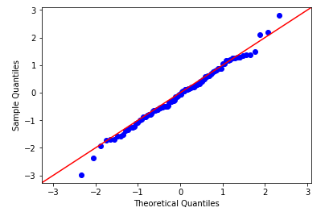
Normal QQ plot
The x axis has points from a theoretically calculated normal distribution
They are compared with sample data on the y axis
If the sample data has a normal distribution the points lie on the reference line

Slide 40
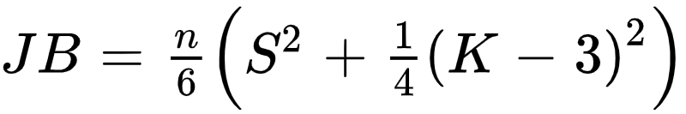
JB test
To test whether the data follows normal distribution, we test whether the skewness and kurtosis of the data are same as that of the normal distribution, i.e. to test
against
Failing to reject H₀, implies that the data does not follow normal distribution
H₀: Skewness (S) = 0 and Kurtosis (K) = 0
H₁: Skewness (S) ≠ 0 and Kurtosis (K) ≠ 0

Slide 41
JB test
The test statistics for n observations is given by
Kurtosis coefficient
Sample skewness
The test statistics asymptotically follows chi squared distribution with 2 degrees of freedom (χ²₂)

Slide 42
Shapiro-Wilk test
To test whether the data follows normal distribution, i.e. to test
against
Failing to reject H₀, implies that the data does not follow normal distribution
H₀: The data is normally distributed
H₁: The data is not normally distributed

Slide 43
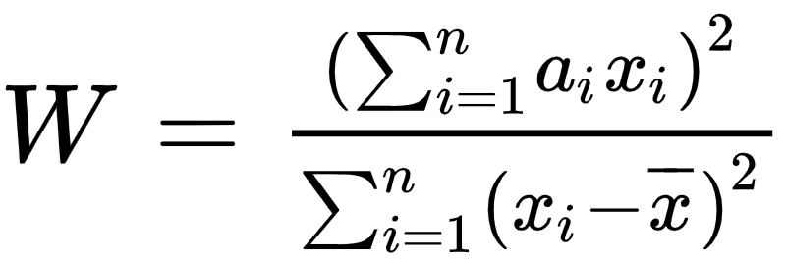
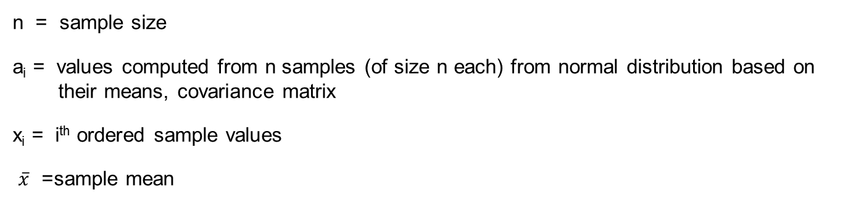
Shapiro-Wilk test statistic
The test statistic is given by
n = sample size
a_{i} = values computed from n samples (of size n each) from normal distribution based on their means, covariance matrix
x_{i} = i^{th} ordered sample values
$\overline{x}$= sample mean

